Slide 1


SENSORED 6.0
IR SENSOR

Slide 2


Let’s START the Theoretical basics of the
IR sensor !!!

Slide 3

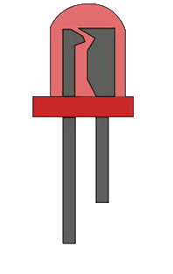
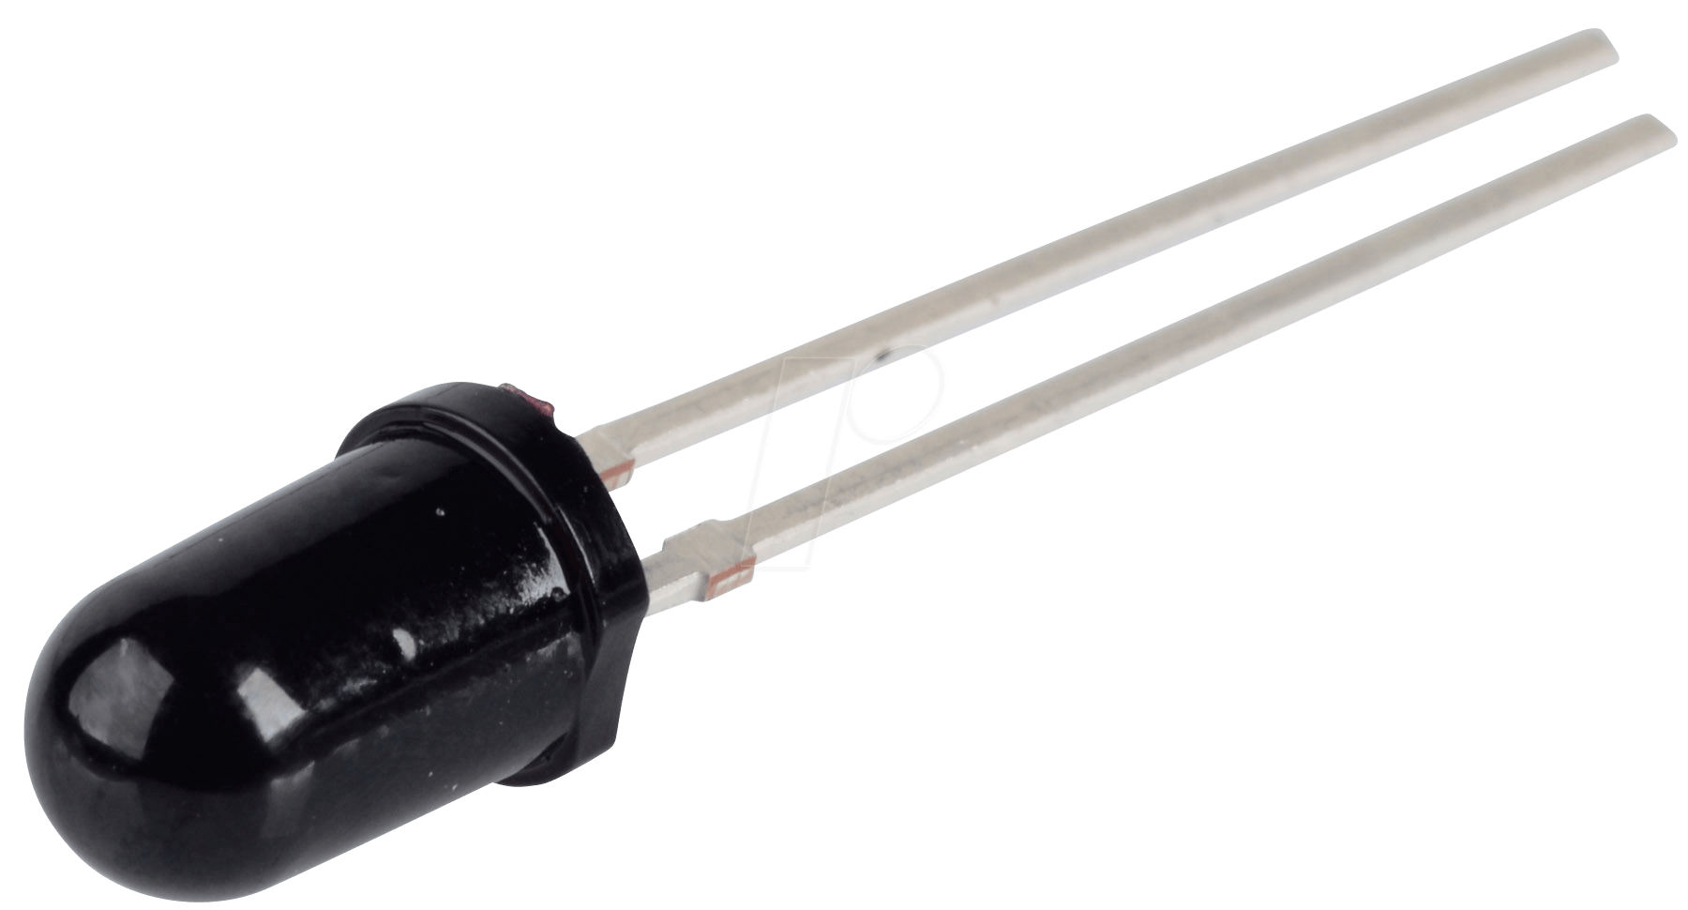
Love Story
of
OPTO-Couple
Photodiode
LED
Notes:
An optocouple is a semiconductor device, where the LED drives the photodiode. That is the LED is the working force behind the device. You will understand how it works in few mins. Have this question in the back of your head.

Slide 4
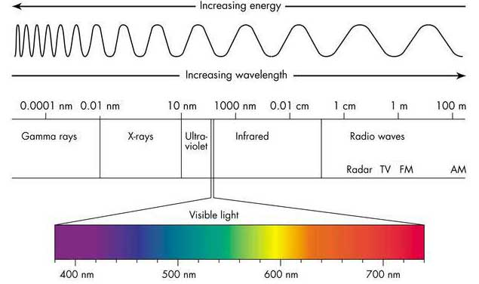
EM SPECTRUM
Notes:
Mention the wavelength range of IR region.

Slide 5
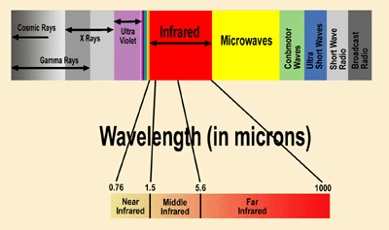
IR REGION SPLITUP
Near IR region
Mid IR region
Far IR region
Notes:
0.78 to 3 micro meters is near IR, 3 – 50 micro meters is mid IR and 50 – 1000 micrometers is far ir.

Slide 6
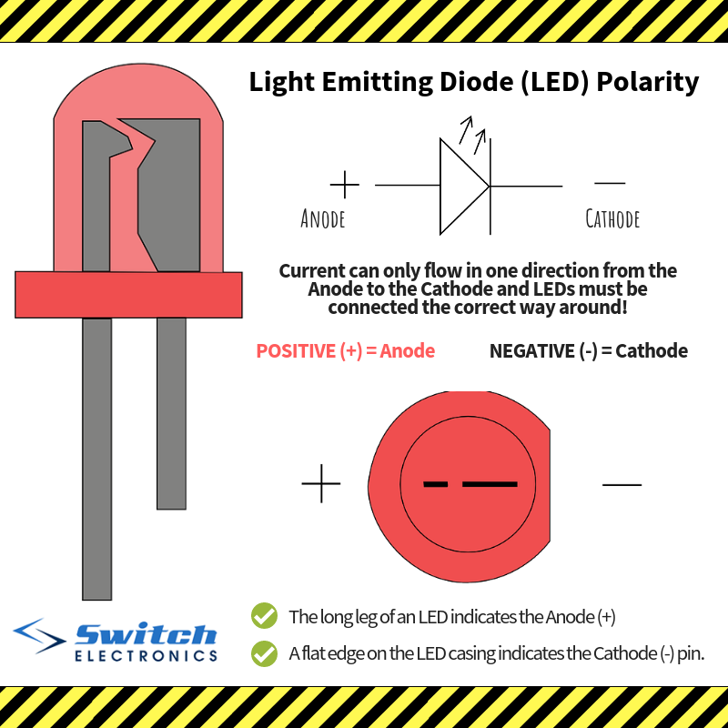
PARTS OF THE IR LED

Slide 7

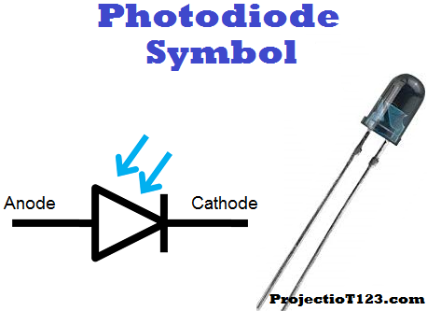
PARTS OF THE PHOTODIODE
The shorter end of the photo-diode is the
cathode and the longer end is anode.
Notes:
The photodiode is basically a pn junction diode, When light falls on the photodiode the charge carriers in the diode increases hence the width of the depletion layer also increases.

Slide 8

Why is the photodiode black ?
Notes:
Summer black clothers analogy

Slide 9
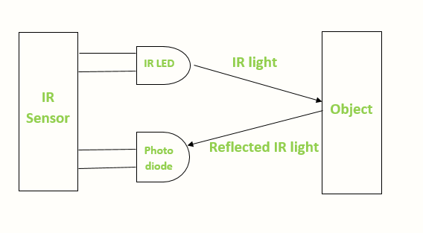
Theory of IR Sensor
How the receiver receives the response the light and how transmission works ?

Slide 10
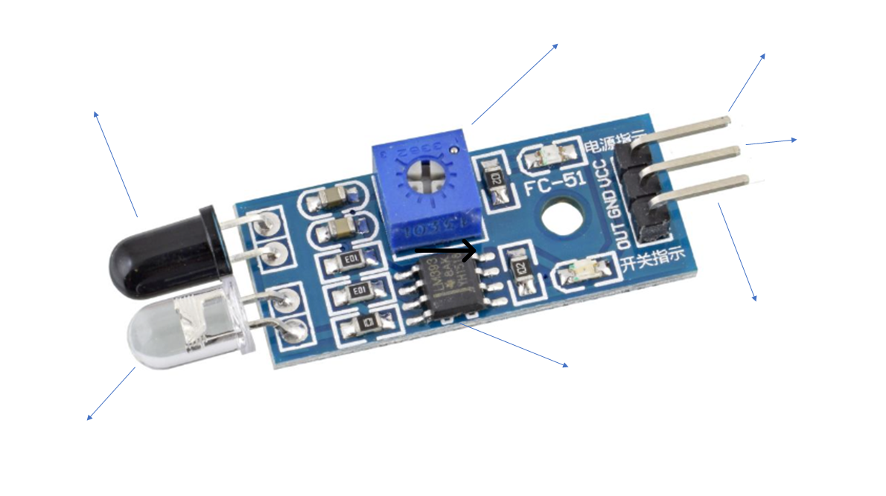
Parts of an IR Sensor
Sensitivity
Manipulator
5V collector current
pin
Receiver photodiode
Ground
pin
Data Pin
LM393 IC
LED
Notes:
What is IC ? Why the IC ? LM393 IC INFO
What is an IC ? An IC stands for integrated circuit, an integrated circuit is made up of a combination of diodes, transistors and micoprocessors. When all these components are put on a silicon wafer we call it an IC chip. The IC chip that is present on the module is called lm393 IC

Slide 11
You Buy a product only if its useful to you in some way or the other.
So lets discuss about the real-life applications of the IR Sensor…

Slide 12
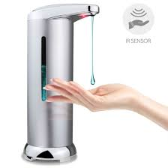


Slide 13
So Other applications include:
Fridge Light Switching
IR Thermometer

Slide 14
Interesting projects
Interesting Projects
Black line following robot
IR contactless bell
Line following robot
Contactless doorbell

Slide 15
drawbacks
Drawbacks of IR Sensor
Unreliable in ambient conditions
Penetration power and low frequency
Unreliable in environment conditions
IR ray at high power can damage your eyes
IR region is very small (700-1000nm)
Sensor range is very low
If the object is black then the ir sensor module might not
sense it.

Slide 16

ARE YOU GUYS READY FOR THE CODING AND HANDS ON PART ???

Slide 17
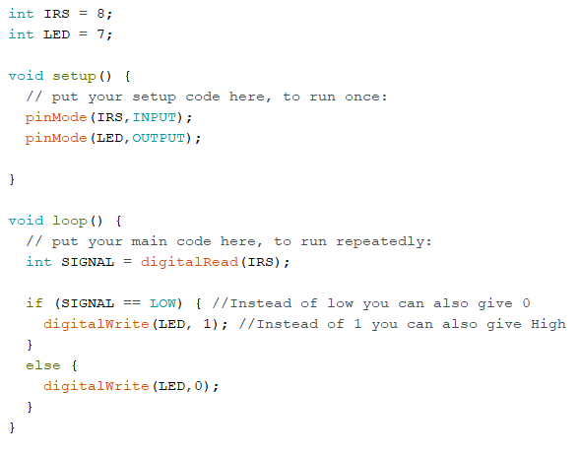
CODE
IRS is the variable which will contain the pin
Number of where the IR sensor module is
connected.
LED is the variable containing the pin number
to which the anode is connected.
The cathode is grounded.
We set the IRS as input and LED as output.
Notes:
Explain void setup and void loop.

Slide 18
int IRS = 8;
int LED = 7;
void setup() {
// put your setup code here, to run once:
pinMode(IRS,INPUT);
pinMode(LED,OUTPUT);
}
void loop() {
// put your main code here, to run repeatedly:
int SIGNAL = digitalRead(IRS);
if (SIGNAL == LOW) { //Instead of low you can also give 0
digitalWrite(LED, 1); //Instead of 1 you can also give High
}
else {
digitalWrite(LED,0);
}
}
Notes:
#define IRS 9
# define LED 11
Explain this.
memory

Slide 19
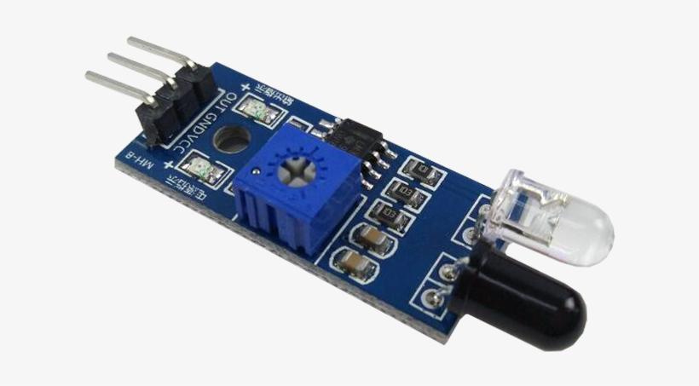
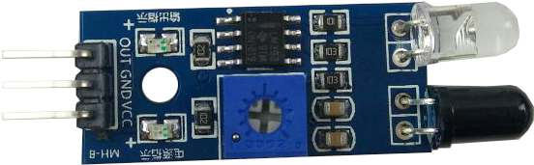
Arduino Nano connection with IR sensor
Legend
Vcc connected to 5v pin
Ground connected to ground
Out/Data pin connected to
digital pin
Notes:
Make the legend for where each pin is getting connected to. On the board to the module.

Slide 20
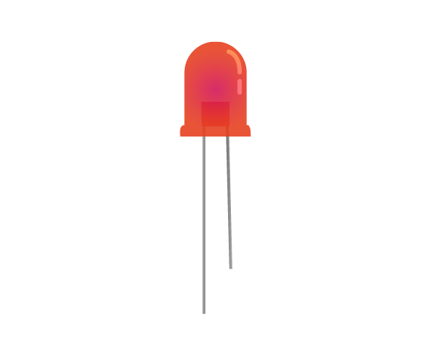
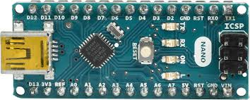
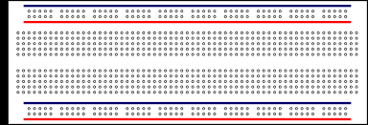

Slide 23
0

Slide 27

THANK YOU

Slide 28
Speakers Srivatsa S A
Abhinav Kar

